Slide 1

Compiler Construction
COMP 7.1
Unit 2

Slide 2

Course Outcomes
Course Outcome No. | CO Description | Cognitive Level
COMP 7.1.1 | Define the components and phases of the compiler, and the types of parsers. | CL1
COMP 7.1.2 | Explain the components and phases of the compiler. | CL2
COMP 7.1.3 | Apply algorithms to design a lexical analyser, construct a parser by hand, generate intermediate code and target code. | CL3
COMP 7.1.4 | Write a LEX/YACC specification for a given Regular Expression and use the LEX/YACC tool. | CL3
Compiler Construction

Slide 3
Unit 2 Syllabus
Overview of Context Free Grammar Questions
Top down parsing Questions
Bottom up parsing Questions
Shift-reduce parsers.
YACC parser generator Questions
Derivations and Parse trees,
Ambiguity,
Left recursion,
Left factoring.
Recursive descent parsing and
Predictive parsers
Operator precedence parsers,
LR parsers

Slide 4
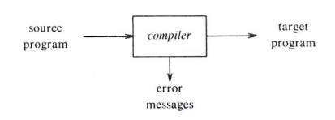
Remember

Slide 5
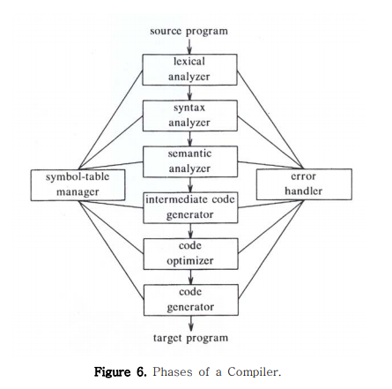
Unit 2
Unit 3

Slide 6
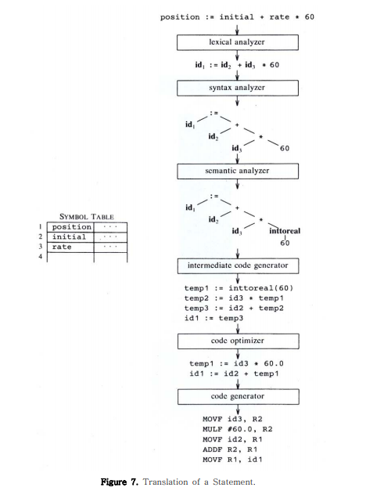
Unit 2
Unit 3

Slide 7
Reference:
Aho, Ulman and Sethi; Compilers, Principles, techniques and tools; Pearson Education Asia, ISBN: 81-7808-046-X.

Slide 8
Chapter 4: Syntax Analysis
Basic Concepts
Techniques for hand implementation
Algorithms for automated tools

Slide 9
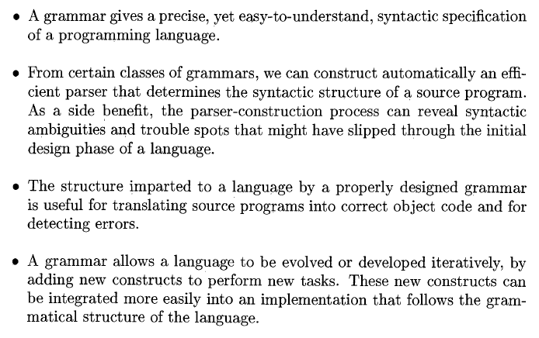
Advantages of using grammars for language designers:

Slide 10
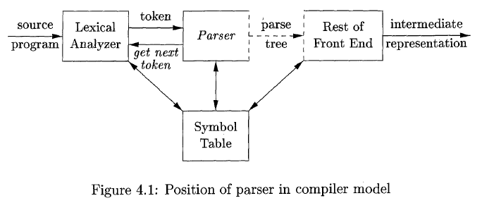
4.1 The role of the parser

Slide 11
1) Obtains a string of tokens from the lexical analyzer
2) Verifies that the string can be generated by the grammar for the source language
3) Reports any syntax errors in an intelligible fashion
4) Recovers from commonly occurring errors so that it can continue processing the remainder of its input.

Slide 12
3 general types of parsers for grammars
Universal parsing methods
Cocke-Younger-Kasami algorithm and Earley’s algorithm
Can parse any grammar
Too inefficient to use in production compilers
Top-down
Build parse trees from the top (root) to the bottom (leaves)
The input to the parser is scanned from left to right, one symbol at a time
Bottom-up
Start from the leaves and work up to the root
The input to the parser is scanned from left to right, one symbol at a time

Slide 13
Assume:
Output of the parser is some representation of the parse tree for the stream of tokens produced by the lexical analyser

Slide 14
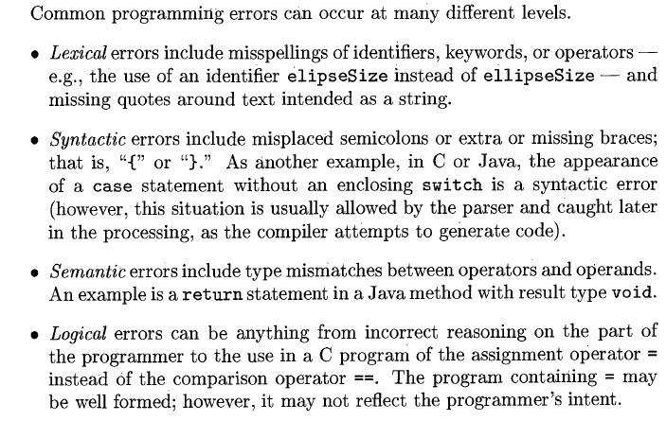
Syntax error handling

Slide 15
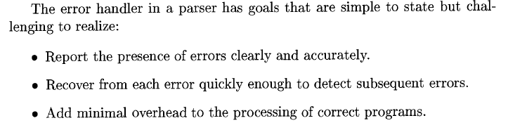
Much of the error detection and recovery in a compiler is centred around the syntax analysis phase
Many errors are syntactic in nature or are exposed when the stream of tokens coming from the lexical analyser disobeys the grammatical rules defining the programming language
Viable-prefix property – detect an error as soon as a prefix of the input is not a prefix of any string in the language

Slide 16
Error-Recovery Strategies
Panic mode
Phrase level
Error productions
Global correction

Slide 17

Panic-mode recovery –
Advantage - Simplest to implement
Can be used by most parsing methods
On discovering an error, the parser discards input symbols one at a time until one of a designated set of synchronizing tokens is found
Synchronizing tokens are often delimiters, whose role in the source program is clear
Skips input without checking it for additional errors
Guaranteed not to go into an infinite loop

Slide 18

Phrase-level recovery-
On discovering an error, a parser may perform local correction on the remaining input
i.e. it may replace a prefix of the remaining input by some string that allows the parser to continue
E.g. replace a comma by a semi-colon, delete an extraneous semicolon, or insert a missing semicolon
If Replacements are inserted in the input ahead of the current input symbol then the parser will go into an infinite loop
Can correct any input string
First used with top-down parsing
Major drawback – difficult to cope when the actual error has occurred before the point of detection.

Slide 19

Error productions
Augment the grammar for the language at hand with productions that generate the erroneous constructs
Use the augmented grammar to construct a parser
If an error production is used by the parser, we can generate appropriate error diagnostics to indicate the erroneous construct that has been recognized in the input

Slide 20

Global correction
Algorithms for choosing a minimal sequence of changes to obtain a globally least-cost correction
Given an incorrect input string ‘x’ and grammar ‘G’, these algorithms will find a parse tree for a related string ‘y’, such that the number of insertions, deletions, and changes of tokens required to transform ‘x’ into ‘y’ is as small as possible
These methods are too costly to implement in time and space
These techniques are of theoretical interest

Slide 21
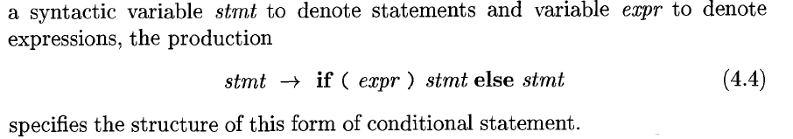
4.2 Context-Free Grammar

Slide 22
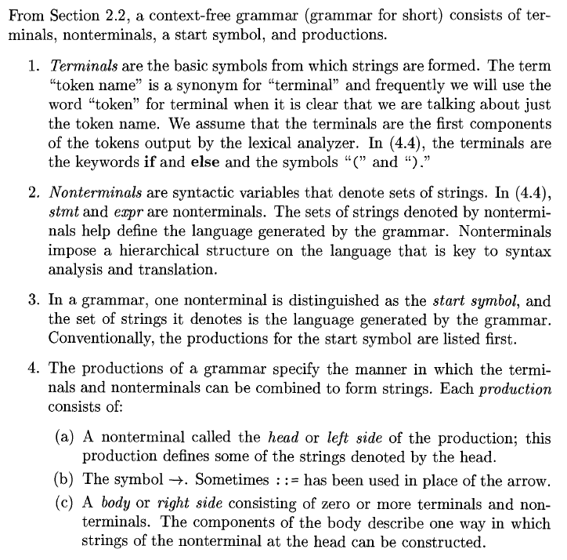

Slide 23
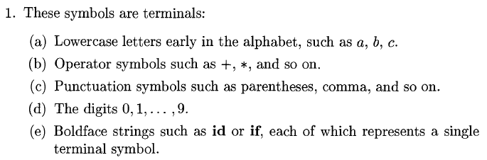
1. Terminals – basic symbols from which strings are formed
also known as “tokens”
e.g. “if”, “then”, “else”, “+”

Slide 24
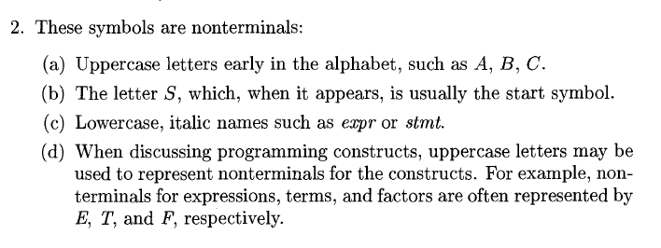
2. Non-terminals
– syntactic variables that denote sets of strings
- define sets of strings that help define the language generated
by the grammar
- impose a hierarchical structure on the language - > useful for
both syntax analysis and translation

Slide 25
3. Start Symbol
– distinguished nonterminal
- the set of strings it denotes is the language defined by the
grammar

Slide 26
4. Productions
- specify the way terminals and non-terminals can be combined to
form strings
- Each production consists of:
a) nonterminal / head / LHS
b) -> or ::=
c) string of non-terminals and terminals / body /RHS

Slide 27
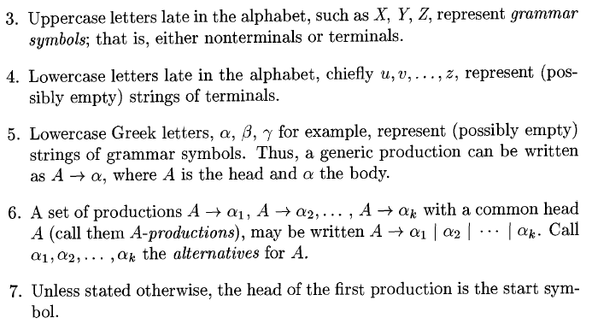
Notations

Slide 28
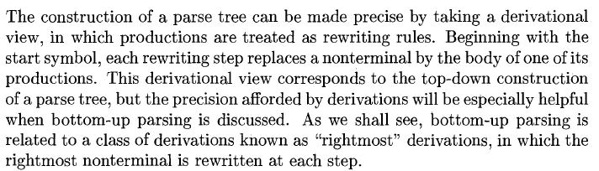
Derivations

Slide 29
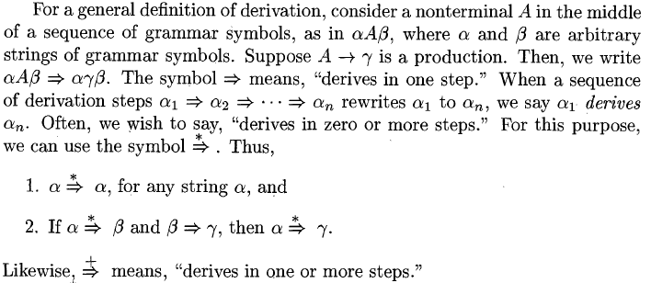

Slide 30
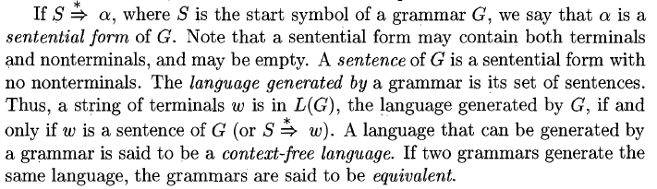

Slide 31
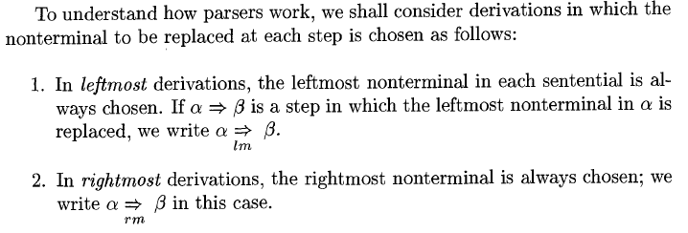

Slide 32
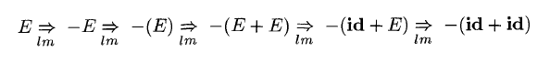

Slide 33
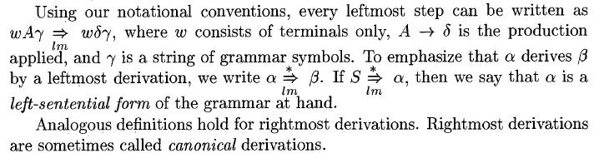

Slide 34
G: S (L) | a
L L, S | S
Construct the leftmost derivation and rightmost derivation for each of the following sentences:
(a, a)
(a, (a, a))
(a, ((a, a),(a, a))

Slide 35
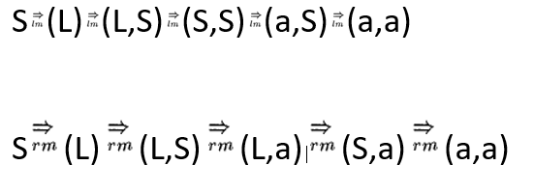

Slide 36
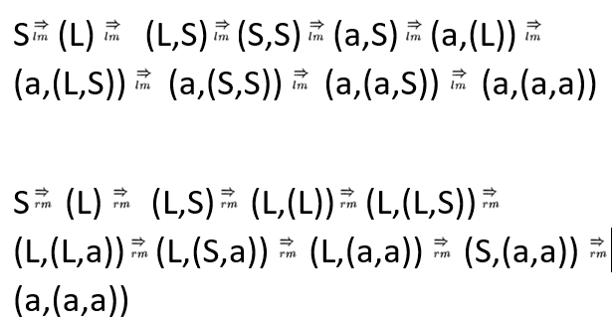

Slide 37
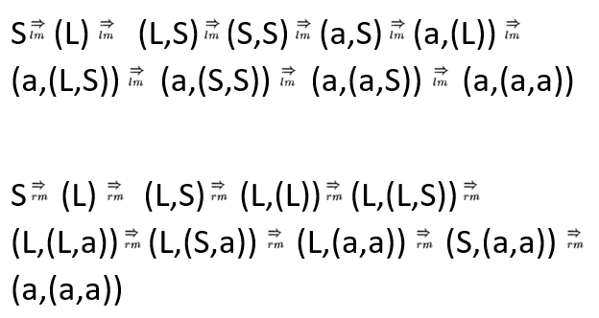

Slide 38
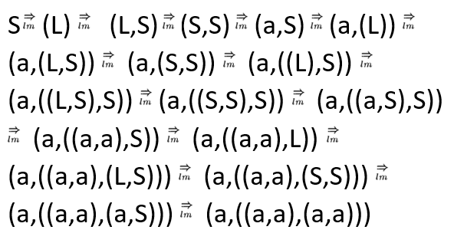

Slide 39
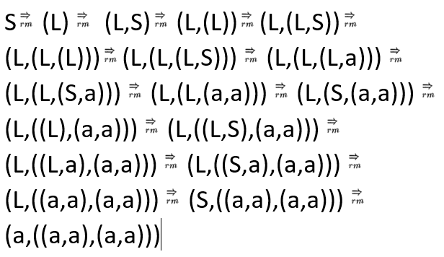

Slide 40
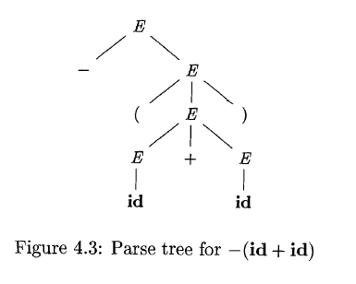
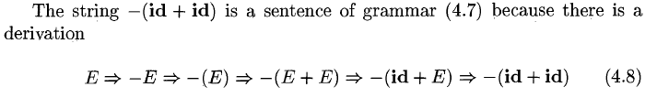
Parse Trees and derivations
Parse tree may be viewed as a graphical representation for a derivation that filters out the choice regarding replacement order

Slide 41
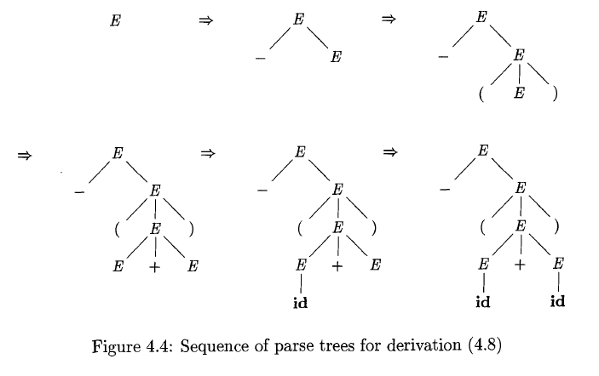

Slide 42
Ambiguity
A grammar that produces more than one parse tree for some sentence is said to be ambiguous
An ambiguous sentence is one that produces more than one leftmost derivation or more than one rightmost derivation for the same sentence

Slide 43
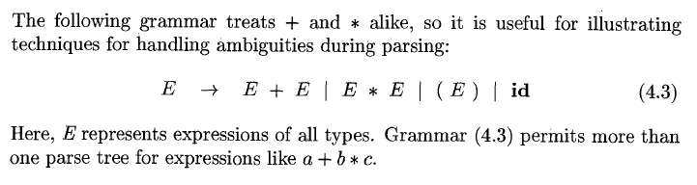
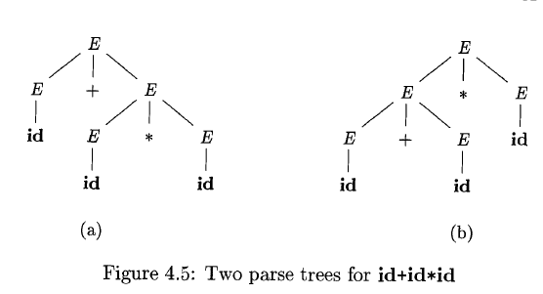
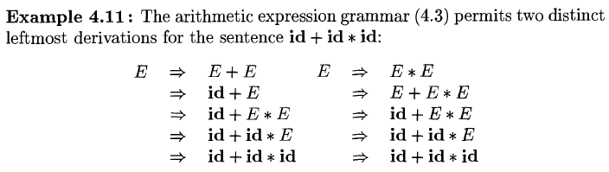

Slide 44
For certain parsers, it is desirable that the grammar be made unambiguous, otherwise a unique parse tree cannot be determined to select for a sentence
For some applications, certain ambiguous grammars can be used together with disambiguating rules that remove undesirable parse trees.

Slide 45
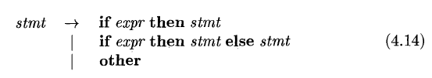
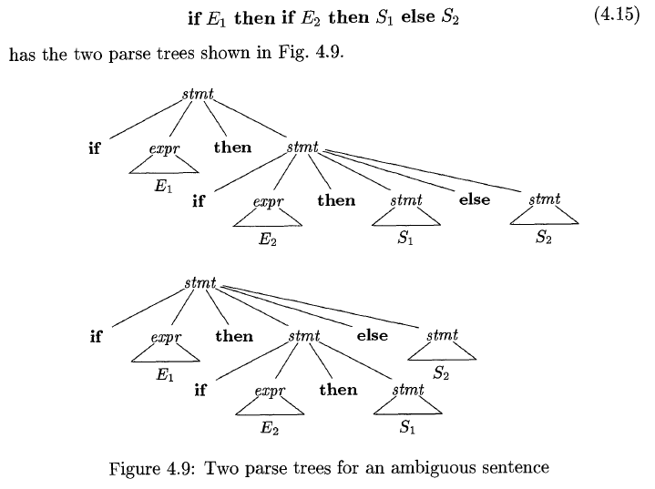

Slide 46
Eliminating ambiguity
Rewrite the grammar

Slide 47
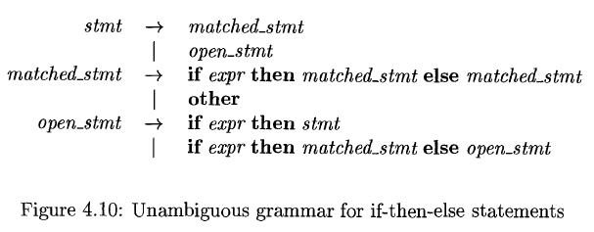

Slide 48
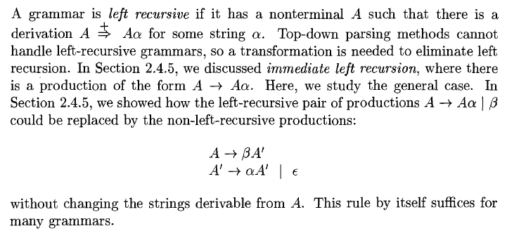
Elimination of left recursion

Slide 49
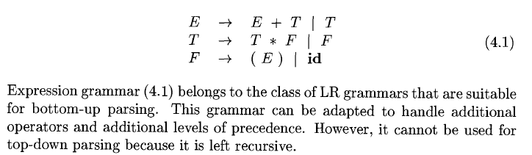
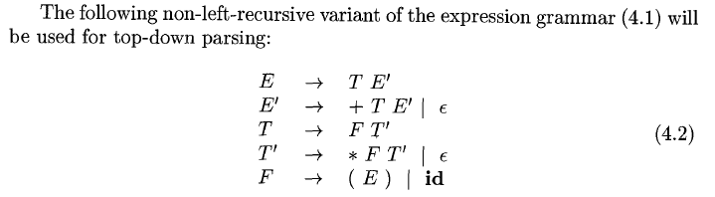

Slide 50
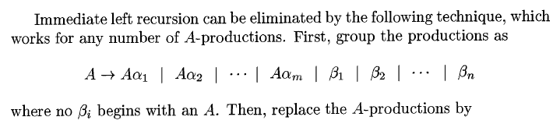
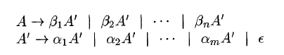

Slide 51
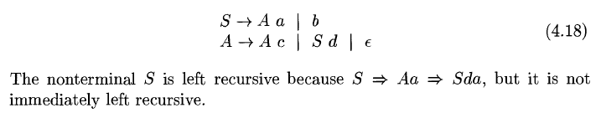

Slide 52
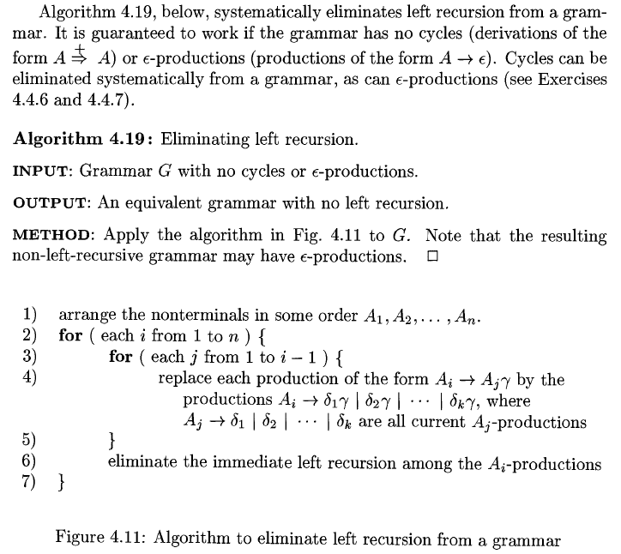

Slide 53
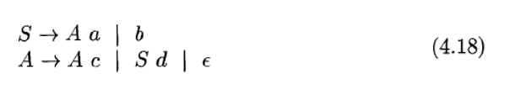
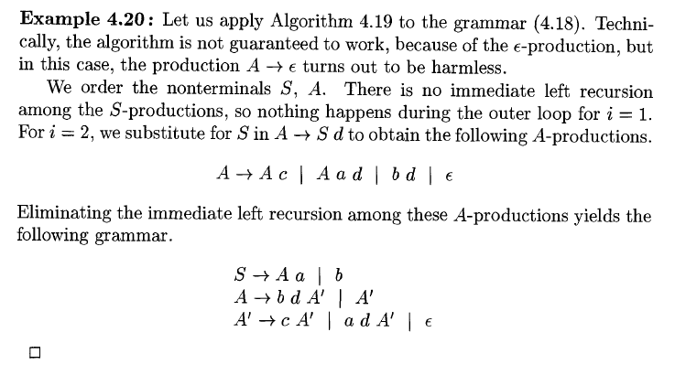

Slide 54
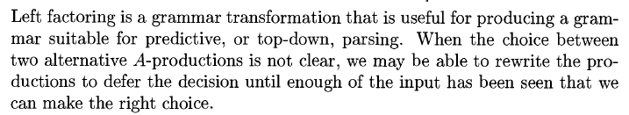
Left Factoring

Slide 55
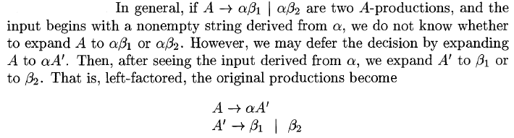

Slide 56
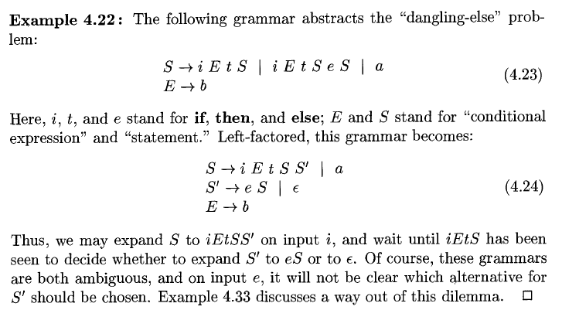
Choose the first alternative

Slide 57
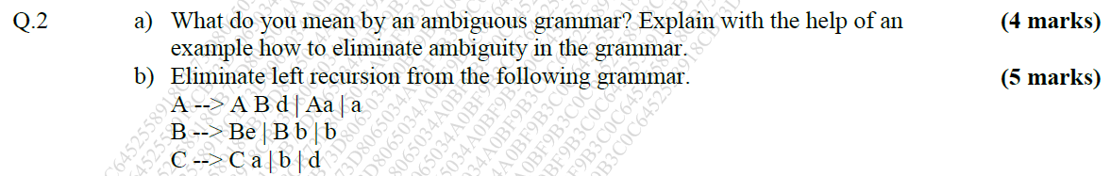
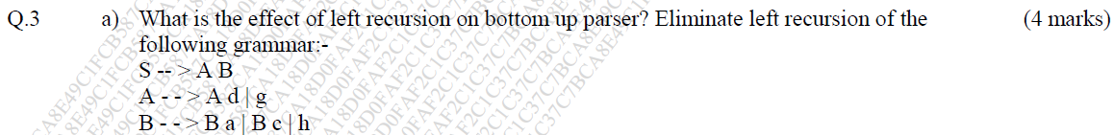
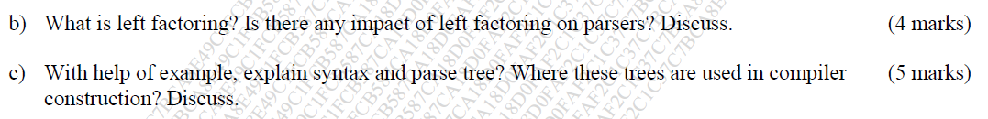
Questions
ND2019
Aug2020

Slide 58
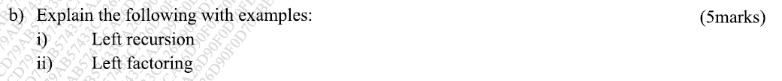
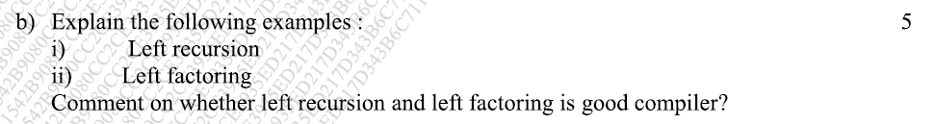
Oct 2020
Aug 2021

Slide 59
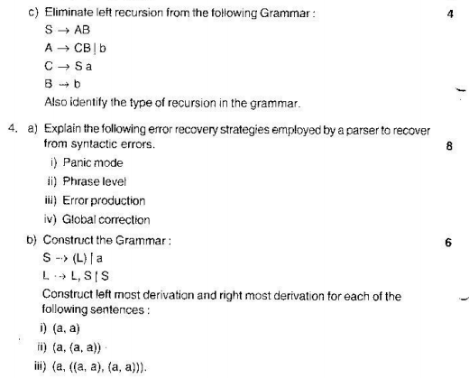
More questions

Slide 60




Slide 61



Slide 62





Slide 63
Questions
The End
of
Overview of Context Free Grammar

Slide 64
4.4 Top-Down Parsing
Basic Ideas
Predictive Parser – an efficient non-backtracking form of top-down parser
Define the class of LL(1) grammars from which predictive parsers can be constructed automatically

Slide 65
Top-down parsing: problem of constructing a parse tree for the input string
Starting with the root and creating the nodes of the parse tree in pre-order (depth-first)
Top-down parsing: an attempt to find a leftmost derivation for an input string

Slide 66
Recursive-Descent Parsing
A general form of a top-down parser
It may involve backtracking, i.e., making repeated scans of the input
Backtracking is rarely needed to parse programming languages constructs
Hence backtracking parsers are not seen frequently
A left-recursive grammar can cause the recursive-descent parser (even with backtracking) to go into an infinite loop

Slide 67



Slide 68




Slide 69
Predictive Parser
Write a grammar
Eliminate left recursion
Left factor the resulting grammar
Such a grammar can be parsed by a recursive-descent parser that needs no backtracking – Predictive parser

Slide 70

Non-recursive Predictive Parser

Slide 71


Slide 72
First and Follow
The construction of both top-down and bottom-up parsers is aided by two functions- FIRST and FOLLOW
During top-down parsing, FIRST and FOLLOW allow us to choose which production to apply, based on the next input symbol
During panic-mode recovery, sets of tokens produced by FOLLOW can be used as synchronizing tokens

Slide 73



Slide 74


Slide 75


Slide 76


E ( E )
E aA

Slide 77



Slide 78


Slide 79
Non-terminal – X | FIRST(X) |  | FOLLOW(X)
E | ( | id | $ |  | )
E’ | + | ϵ | $ |  | )
T | ( | id | + | $ | )
T’ | * | ϵ | + | $ | )
F | ( | id | * | + | $ | )

Slide 80



Slide 81

Non-terminal – X | FIRST(X) |  | FOLLOW(X)
E | ( | id | $ |  | )
E’ | + | ϵ | $ |  | )
T | ( | id | + | $ | )
T’ | * | ϵ | + | $ | )
F | ( | id | * | + | $ | )

Slide 82



Slide 83



Slide 84
G: E aA | (E)
A +E | *E |ϵ
S: (a+a*a+a)
Solution:
Check left recursion
Check left factors
Find FIRST and FOLLOW
Construct the Parsing Table M
Parse the String

Slide 85

Follow:
Rule 2: A -> αBβ
E -> (E)
Rule 3: A -> αB
E -> aA
X | FIRST(X) |  |  | FOLLOW(X)
E | a | ( |  | $ | )
A | + | ϵ | * | $ | )

Slide 86

No left recursion
No left factors
X | FIRST(X) |  |  | FOLLOW(X)
E | a | ( |  | $ | )
A | + | ϵ | * | $ | )
Non-Terminal | Input Symbol
 | a | + | * | ( | ) | $
E | E aA |  |  | E (E)
A |  | A +E | A *E |  | A | A
ϵ
ϵ

Slide 87

Stack | Input | Output
$E | (a+a*a+a)$ | E (E)
$)E( | (a+a*a+a)$
$)E | a+a*a+a)$
$)Aa | a+a*a+a)$
$)A | +a*a+a)$
$)E+ | +a*a+a)$
$)E | a*a+a)$
$)Aa | a*a+a)$
$)A | *a+a)$
$)E* | *a+a)$
$)E | a+a)$
$)Aa | a+a)$
$)A | +a)$
$)E+ | +a)$
$)E | a)$
$)Aa | a)$
$)A | )$
$) | )$
$ | $ | Success

Slide 88
For some grammars the predictive parsing table M may have some entries that are multiply-defined
If the grammar G is left-recursive or ambiguous, then M will have at least one multiply-defined entry
The ambiguity can be resolved by choosing one of the multiple entries
A grammar whose parsing table has no multiply-defined entries is said to be LL(1)

Slide 89
LL(1) Grammars
Predictive parsers can be constructed for a class of grammars called LL(1)
L – scanning the input from left-to-right
L – for producing a leftmost derivation
1 – one input symbol of lookahead at each step to make parsing action decisions

Slide 90

Properties of LL(1) grammars:
No left-recursive or ambiguous grammar can be LL(1)

Slide 91

Grammar modelling if-then-else statement is not LL(1)
When a parsing table has multiply-defined entries:
Transform the grammar by eliminating all left recursion and then left factoring whenever possible
For some grammar no amount of alteration will yield an LL(1) grammar e.g. 4.23. The grammar can be parsed with a predictive parser by choosing one of the productions.
In general, there are no universal rules by which multiply-defined entries can be made single-valued without affecting the language recognized by the parser.
Use a Predictive parser for control constructs
Use an Operator Precedence parser for expressions

Slide 92
Error Recovery in Predictive Parsing
An error is detected during predictive parsing when:
the terminal on the top of the stack does not match the next input symbol or
when NT ‘A’ is on top of the stack, ‘a’ is the next input symbol, and the parsing table entry M[A, a] is empty
Panic-mode error recovery is based on skipping symbols on the input until a token in a selected set of synchronizing tokens appears
Phrase-level recovery is implemented by filling in the blank entries in the predictive parsing table with pointers to error routines

Slide 93


Questions
Aug 2020

Slide 94



More questions

Slide 95




Slide 96




Slide 97



Slide 98
Questions
The End
of
Top-down Parsing

Slide 99
4.5 Bottom-Up Parsing
Shift-Reduce parsing is a general style of bottom-up syntax analysis
Operator-precedence parsing is an easy-to-implement form of shift-reduce parsing
LR parsing is a general method of shift-reduce parsing. It is used in a number of automatic parser generators

Slide 100
Shift-reduce parsing attempts to construct a parse tree for an input string beginning at the leaves (the bottom) and working up towards the root (the top)
Think of this process as one of “reducing” a string “w” to the start symbol of a grammar.
At each reduction step a particular substring matching the right side of a production is replaced by the symbol on the left of that production
If the substring is chosen correctly at each step, a rightmost derivation is traced out in reverse

Slide 101



Slide 102

Handles
A “handle” of a string is a substring that:
matches the right side of a production, and
whose reduction to the nonterminal on the left side of the production represents one step along the reverse of a rightmost derivation.
In many cases the leftmost substring β that matches the right side of some production A β is not a handle, because a reduction by the production yields a string that cannot be reduced to the start symbol

Slide 103

Definition: A handle of a right-sentential form γ is a production
and a position of γ where the string β may be found and replaced by A to produce the previous right-sentential form in a rightmost derivation of γ
That is, if , then in the position following α is a handle of αβw.
The string w to the right of the handle contains only terminal symbols.

Slide 104


Note: we say ‘a handle’ rather than ‘the handle’ because the grammar could be ambiguous, with more than one rightmost derivation of αβw
If a grammar is unambiguous, then every right-sentential form of the grammar has exactly one handle
Sometimes we say “the substring β is a handle of αβw” if the position of β and the production we have in mind are clear.

Slide 105

Handle Pruning
It is a way of obtaining a rightmost derivation in reverse

Slide 106
Stack implementation of Shift-Reduce Parsing
To parse by handle pruning:
Locate the substring to be reduced in a right-sentential form
Determine what production to choose in case there is more than one production with that substring on the right side
The type of data structure to use in a shift-reduce parser - Stack to hold grammar symbols
Input buffer to hold the string w to be parsed
$ marks the bottom of the stack and also the right end of the input

Slide 107


Initially, the stack is empty, and the string w is in the input buffer, as follows:
The parser operates by shifting zero or more input symbols onto the stack until a handle β is on top of the stack.
The parser then reduces β to the left side of the appropriate production
The parser repeats this cycle until it has detected an error or until the stack contains the start symbol and the input is empty:
After entering this configuration, the parser halts and announces successful completion of parsing

Slide 108
The 4 actions of a shift-reduce parser
Shift – the next input symbol is shifted onto the top of the stack
Reduce – the parser knows the right end of the handle is at the top of the stack. It must then locate the left end of the handle within the stack and decide with what nonterminal to replace the handle
Accept – the parser announces successful completion of parsing
Error – the parser discovers that a syntax error has occurred and calls an error recovery routine.

Slide 109



The handle will always eventually appear on top of the stack, never inside
This fact justifies the use of a stack in a shift-reduce parser

Slide 110
Viable Prefixes
The set of prefixes of right sentential forms that can appear on the stack of a shift-reduce parser are called viable prefixes
Another Definition: It is a prefix of a right-sentential form that does not continue past the right end of the rightmost handle of that sentential form
It is always possible to add terminal symbols to the end of a viable prefix to obtain a right-sentential form.
Therefore, there is apparently no error as long as the portion of the input seen to a given point can be reduced to a viable prefix

Slide 111
Conflicts during Shift-Reduce Parsing
There are context-free grammars for which shift-reduce parsing cannot be used
Every shift-reduce parser for such a grammar can reach a configuration in which the parser, knowing the entire stack contents and the next input symbol, cannot decide:
whether to shift or to reduce (a shift/reduce conflict), or
which of several reductions to make ( a reduce/reduce conflict)
These grammars are not in the LR(k) class of grammars and are referred to as non-LR grammars
The ‘k’ refers to the number of symbols of lookahead on the input
Grammars used in compiling usually fall in the LR(1) class, with one symbol lookahead

Slide 112

Syntactic constructs that give rise to such grammars

Slide 113

4.6 Operator-Precedence Parsing
Small but important class of grammars
Efficient shift-reduce parsers can be constructed by hand
Operator Grammar – These grammars have the property that no production right side is ε or has two adjacent non-terminals

Slide 114
Disadvantages of operator-precedence parsing
It is hard to handle tokens like the minus sign, which has two different precedencies (depending on whether it unary or binary)
One cannot be sure the parser accepts exactly the desired language
Only a small class of grammars can be parsed using operator-precedence techniques
Advantages of operator-precedence parsing
Simplicity
Numerous compilers using operator-precedence parsing techniques for expressions have been built successfully

Slide 115



Slide 116

Notes:
Reference: Principles of compiler Design – Aho and Ullman

Slide 117


Slide 118


Slide 119
The computation of TRAILING:
‘a’ is in TRAILING(A) if there is a production of the form A γaδ, where δ is ε or a single non-terminal
2. If ‘a’ is in TRAILING(B), and there is a production of the form A αB,
then ‘a’ is in TRAILING(A).
More Rules for Leading “L” and Trailing “B”:
Rule 3: If A B then put the set Leading(B) in Leading(A); put the set Trailing(B) in Trailing (A).
Rule 4: If A a then Leading(A) = Trailing(A) = {a}

Slide 120
G: E EAE | (E) | id
A + | *
Step 1: Convert the Grammar to Operator Grammar
G’: E E+E | E*E | (E) |id
Step 2: Removing ambiguity
G’’: E E+T | T
T T*F | F
F (E) | id

Slide 121



Step 3: Calculate Leading and Trailing of G’’
X | Leading (X) |  |  |  | Trailing (X)
E | + | * | ( | id | + | * E T | ) | id
T | * | ( T F | id |  | * | ) T F | id
F | ( | id F id |  |  | ) | id F id
E T

Slide 122


Step 4: Assign Precedencies
$ Leading(S)
Trailing(S) $

Slide 123


Slide 124


Slide 125


Slide 126

Row ------- Column
Row ------- Column
(E ) => ( )
E+T => + Leading(T) = { *, (, id}
T*F => * L(F) = {(, id}
(E) => ( L(E) = {*, +, (, id}
$ L(E ) = {*, +, (, id}
E+T => Trailing(E) ={+, *, ), id} +
T*F => T(T) ={*, ), id} *
=> T(E) ={+, *, ), id} )
T(E) ={+, *, ), id} $

Slide 127


Slide 128


Slide 129


Stack | Input Buffer | Action
$ | id + id * id $ | shift
$ id | + id * id $ | reduce
$ id | + id * id $ | pop
$ | + id * id $ | shift
$ + | id * id $ | shift
$ + id | * id $ | shift
$ + id | * id $ | Pop
$ + | * id $ | shift
$ + * | id $ | shift
$ + * id | $ | reduce
$ + * id | $ | Pop
$ + * | $ | reduce
$ + * | $ | Pop
$ + | $ | reduce
$ + | $ | Pop
$ | $ | Accept
Notes:
Blanks denote error entries

Slide 130
Error Recovery in Operator-Precedence Parsing
There are 2 points in the parsing process at which an operator-precedence parser can discover syntactic errors:
If no precedence relation holds between the terminal on top of the stack and the current input
If a handle has been found, but there is no production with this handle as a right side

Slide 131
Handling errors during reduction:
Pop symbols off the stack.
As there is no production to reduce by, no semantic actions are taken; a diagnostic message is printed instead
Handling Shift/Reduce errors:
If no relation holds between the top stack symbol and the first input symbol, then modify the stack or the input or both
If inserting or changing be careful not to get into an infinite loop
By guaranteeing that after recovery the current input symbol can be shifted

Slide 132
For each blank entry in the precedence matrix we must specify an error-recovery routine
The same routine could be used in several places
Then when the parser consults the entry and no precedence relation holds it finds a pointer to the error-recovery routine for this error

Slide 133


Questions
ND2019
Aug2020

Slide 134


Slide 135
G: S a | ^ | (T)
T T,S | S
Step 1: Grammar is Operator Grammar
Step 2: No ambiguity
Step 3: Calculate Leading and Trailing of G

Slide 136
Step 3: Calculate Leading and Trailing of G’’
X | Leading (X) |  |  |  | Trailing (X)
S | a | ^ | ( |  | a | ^ | )
T | , | a | ^ | ( | , | a | ^ | )
T S

Slide 137
Pattern Row Column
tt or t-NT-t ( )
t-NT ( L(T)
, L(S)
NT-t T(T) )
T(T) ,
$ L(S)
T(S) $

Slide 138

 | a | ^ | ( | ) | , | $
a
^
(
)
,
$

Slide 139
Stack | Input Buffer | Action
$ | (a, ^)$ | shift
$ ( | a,^)$ | shift
$ ( a | ,^)$ | reduce
$ ( a | ,^)$ | pop
$ ( | ,^)$ | shift
$ ( , | ^)$ | shift
$ ( , ^ | )$ | reduce
$ ( , ^ | )$ | pop
$ ( , | )$ | reduce
$ ( , | )$ | pop
$ ( | )$ | shift
$ ( ) | $ | reduce
$ ( ) | $ | Pop
$ | $ | Accept
((a,a),^,(a))

Slide 140
Questions
The end
Of
Operator-Precedence Parsers

Slide 141
4.7 LR Parsers
Efficient, bottom-up syntax analysis technique
Can be used to parse a large class of context-free grammars
The technique is called LR(k) parsing:
L is for left-to-right scanning of the input
R for constructing a rightmost derivation in reverse
k for the number of input symbols of lookahead that are used in making parsing decisions. When (k) is omitted, k is assumed to be 1

Slide 142
LR parsing is attractive for a variety of reasons:
LR parsers can be constructed to recognize virtually all programming-language constructs for which context-free grammars can be written
The LR parsing method is the most general nonbacktracking shift-reduce parsing method known, yet it can be implemented as efficiently as shift-reduce methods
The class of grammars that can be parsed using LR methods is a proper superset of the class of grammars that can be parsed with predictive parsers
An LR parser can detect a syntactic error as soon as it is possible to do so on a left-to-right scan of the input

Slide 143
The principal drawback of the method is that it is too much work to construct an LR parser by hand for a typical programming-language grammar.
One needs a specialized tool – an LR parser generator
Ex. YACC
Write a CFG and the generator will produce a parser for that grammar
If the grammar contains ambiguities or other constructs that are difficult to parse in a left-to-right scan of the input, then the parser generator can locate these constructs and inform the compiler designer of their presence

Slide 144
Three techniques for constructing an LR parsing table for a grammar:
Simple LR (SLR)
Easiest to implement
Least powerful of the three
It may fail to produce a parsing table for certain grammars on which the other methods succeed
Canonical LR
Most powerful
Most expensive
Lookahead LR (LALR)
Intermediate in power and cost between the other two
Works on most programming-language grammars
Can be implemented efficiently with some effort

Slide 145

The LR Parsing Algorithm

Slide 146


Slide 147


Slide 148


Slide 149


Slide 150


Slide 151


Slide 152


Slide 153


Slide 154


Slide 155
LR Grammars
In order for a grammar to be LR it is sufficient that a left-to-right shift-reduce parser be able to recognize handles when they appear on top of the stack
The state symbol on top of the stack contains all the information that the parser needs to know when the handle appears on top
There is a finite automaton that can, by reading the grammar symbols on the stack from top to bottom, determine what handle, if any, is on top of the stack.
The “goto” function is such a finite automaton

Slide 156
The next ‘k’ input symbols can be used to help the LR parser make its shift-reduce decisions
A grammar that can be parsed by an LR parser examining up to ‘k’ input symbols on each move is called an LR(k) grammar
LL grammar - must be able to recognize the use of a production seeing only the first ‘k’ symbols of what its right side derives
LR grammar – must be able to recognize the occurrence of the right side of a production, having seen all of what is derived from that right side with ‘k’ input symbols of lookahead.

Slide 157

Constructing SLR Parsing Tables

Slide 158


Slide 159


Slide 160


Constructing SLR parser
G:

Slide 161



Step 1
Augment the grammar:
:

Slide 162
Step 2
Calculate closure of Item Sets [E’ -> .E]

Slide 163


Slide 164


Slide 165


Slide 166


Slide 167



=
=
(0)
(1)
(2)
(3)
(4)
(5)
(6)

Slide 168

Step 3
Compute GOTO

Slide 169

Step 4
The set-of-items construction

Slide 170
Applying Steps 3 and 4

Slide 171

Closure(E’->.E) =
Goto(I₀, id) =
Goto(I₁, +) =
Goto(I₄, T)= I₂
Goto(I₄, F)= I₃
Goto(I₄, ()= I₄
Goto(I₄, id)= I₅
Goto(I₆, F)= I₃
Goto(I₆, ()= I₄
Goto(I₆, id)= I₅
Goto(I₇, ()= I₄
Goto(I₄, id)= I₅
Goto(I₈, +)= I₆
Goto(I₉, *)= I₇
Goto(I₀, E) =
Goto(I₂, *) =
Goto(I₀, T) =
Goto(I₄, E) =
Goto(I₀, F) =
Goto(I₆, T) =
Goto(I₀, () =
Goto(I₇, F) =
Goto(I₈, )) =

Slide 172
Step 5
Construct the parsing table
Find the First and Follow sets
Non-terminal – X | FIRST(X) |  | FOLLOW(X)
E | ( | id | $ | ) | +
T | ( | id | + | ) | * | $
F | ( | id | * | $ | ) | +

Slide 173



Slide 174





Slide 175


Slide 176


Slide 177


Slide 178


Slide 179


Slide 180
Aug2020

Slide 181
Questions
The end
Of
SLR Parser

Slide 182
Constructing Canonical LR Parsing Tables
Recall:
In the SLR method, state ‘i’ calls for reduction by A -> α if the set of items Ii contains item [A -> α .] and ‘a’ is in FOLLOW(A)
In some situations, however, when state ‘i’ appears on top of the stack, the viable prefix βα on the stack is such that βα cannot be followed by ‘a’ in a right-sentential form.
Thus, the reduction by A -> α would be invalid on input ‘a’.

Slide 183

It is possible to carry more information in the state that will allow us to rule out some of these invalid reductions by A -> α
By splitting states when necessary, we can arrange to have each state of an LR Parser indicate exactly which input symbols can follow a handle α for which there is a possible reduction to A
The extra information is incorporated into the state by redefining items to include a terminal symbol as a second component
The general form of an item becomes where
is a production
‘a’ is a terminal or the right end marker $
Such an object is called an LR(1) item
The 1 refers to the length of the second component, called the lookahead of the item

Slide 184



Slide 185


Slide 186


Slide 187

G:
Non-terminal – X | FIRST(X)
S | c | d
C | c | d

Slide 188

G’:

Slide 189

Step 2: Closure of [S’ -> .S, $]

Slide 190


ε

Slide 191


Slide 192

Step 2: Closure of [S’ -> .S, $]
(0)
(1)
(2)
(3)

Slide 193

Steps 3 and 4

Slide 194


Goto(I₀, S) =
Goto(I₀, C) =

Slide 195


Goto(I₀, c) =

Slide 196

Goto(I₀, d) =
Goto(I₂, C) =
Goto(I₂, c) =

Slide 197




Slide 198

Goto(I₃, c)= I₃
Goto(I₃, d)= I₄
Goto(I₆, c)= I₆
Goto(I₆, d)= I₇

Slide 199


Slide 200


Slide 201


Stack | Input Buffer | Action
0 | dd$ | s4
0d4 | d$ | r3
0C2 | d$ | s7
0C2d7 | $ | r3
0C2C5 | $ | r1
0S1 | $ | acc
(0)
(1)
(2)
(3)

Slide 202


Slide 203

Constructing LALR tables

Slide 204


Slide 205



To compute the LALR table:
Solve using the canonical parsing method.
Augment the grammar
Closure(S’ -> .S,$)
3 & 4) Compute Goto(I, X) and the set-of-items construction
5) Identify the LR(1) items that have the same core, i.e., only the elements after the comma are different.

Slide 206



Slide 207


Stack | Input Buffer | Action
0 | dd$ | s47
0d47 | d$ | r3
0C2 | d$ | s47
0C2d47 | $ | r3
0C2C5 | $ | r1
0S1 | $ | acc

Slide 208

ND2019

Slide 209
X | FIRST(X)
S | id
E | ( | id
Step 1: Augment the grammar
G’: (0) S ’ -> S
(1) S -> id E E
(2) E -> (E)
(3) E -> E Num
(4) E -> id

Slide 210
Step 2: Closure(S’ -> .S, $) = I₀ = S’ -> .S, $
S -> .id E E, $

Slide 211
Steps 3 and 4:
Goto(I₀, S) = I₁ = S’ -> S., $
Goto(I₀, id) = I₂ = S -> id. E E, $
E -> .(E), ( / id /Num
E -> .E Num, (/id/Num
E -> .id, (/id/Num

Slide 212
Goto(I₂, E) = I₃ = S -> id E. E, $
E -> .(E), $/Num
E -> .E Num, $/Num
E -> .id, $/Num
E -> E.Num, Num/(/id
Goto(I₂, () = I₄ = E -> (.E), (/id/Num
E -> .(E), )/Num
E -> .E Num, )/Num
E -> id, )/Num
Goto(I₂, id) = I₅ = E -> id., (/id/Num
Goto(I₃, E) = I₆ = S -> id E E.,$
E -> E.Num,$/Num
Goto(I₃, () = I₇ = E -> (.E), $/Num
E -> .(E), )/Num
E -> .E Num, )/Num
E -> id, )/Num
Goto(I₃, id) = I₈ = E -> id., $/Num
Goto(I₃, Num) = I₉ = E -> E Num., Num/(/id
Goto(I₄, E) = I₁₀ = E -> (E.), (/id/Num
E -> E. Num, )/Num
Goto(I₄, () = I₁₁ = E -> (.E), )/Num
E -> .(E), )/Num
E -> .E Num, )/Num
E -> id, )/Num

Slide 213
Goto(I₄, id) = I₁₂ = E -> id.,)/Num
Goto(I₆, Num)=I₁₃=E ->ENum.,Num/$
Goto(I₇, E) = I₁₄ = E -> (E.), $/Num
E -> E. Num, )/Num
Goto(I₇, () = I₁₁
Goto(I₇, id) = I₁₂
Goto(I₁₀, )) = I₁₅ = E -> (E)., (/id/Num
Goto(I₁₀,Num)=I₁₆=E->Enum.,)/Num
Goto(I₁₁, E) = I₁₇ = E-> (E.), )/Num
E-> E. Num,)/Num
Goto(I₁₁, () = I₁₁
Goto(I₁₁, id) = I₁₂
Goto(I₁₄, )) = I₁₈ = E -> (E)., $/Num
Goto(I₁₄, Num) = I₁₆
Goto(I₁₇, )) = I₁₉ = E -> (E)., )/Num
Goto(I₁₇, Num) = I₁₆

Slide 214
State | Action |  |  |  |  |  | Goto
 | id | ( | ) | Num | id | $ | S | E
0 | S2
1 |  |  |  |  |  | Acc
2 | s5 | S4 |  |  |  |  |  | 3
3 | s8 | s7 |  | S9 |  |  |  | 6
4 | s12 | s11 |  |  |  |  |  | 10
5 | r4 | r4 |  | R4
6 |  |  |  | s13 |  | R1
7 | s12 | S11 |  |  |  |  |  | 14
8 |  |  |  | r4 |  | R4
9 |  | r3 |  | r3 | R3
10 |  |  | s15 | S16
11 | s12 | S11 |  |  |  |  |  | 17
12 |  |  | r4 | R4
13 |  |  |  | r3 |  | R3
14 |  |  | s18 | S16
15 | r2 | r2 |  | R2
16 |  |  | r3 | R3
17 |  |  | s19 | S16
18 |  |  |  | r2 |  | R2
19 |  |  |  | r2 |  | r2

Slide 215
Questions
The end
Of
Canonical LR Parser and LALR Parser

Slide 216
4.9 Parser Generators
A parser generator can be used to facilitate the construction of the front end of a compiler
YACC is a LALR parser generator
It implements many of the concepts discussed in 4.7 and 4.8
It is widely available
YACC stands for “Yet Another Compiler-Compiler”
It is available as a command on the UNIX system

Slide 217


Slide 218


Slide 219


Slide 220

A translator can be constructed using YACC as shown below
A file, say translate.y, containing a YACC specification of the translator is prepared.
The UNIX system command yacc –d translate.y transforms the file translate.y into a C program called y.tab.c using the LALR method.
Compiling y.tab.c: gcc y.tab.c we obtain the desired object program a.out that performs the translation specified by the original YACC program.
run as ./a.out
Notes:
-d option will cause the header file y.tab.h to be written. The #define statements that associate the token numbers assigned by YACC with the user-declared token names. This allows source files other than y.tab.c to access the token codes.

Slide 221


Slide 222
The program y.tab.c is a representation of an LALR parser written in C, along with other C routines that the user may have prepared.
The LALR parser is compacted.
All the grammars in the grammar specification will be automatically converted into C statements by the YACC tool and will be put under the function name of yyparse().
A YACC source program has three parts:
Declarations
%%
Translation rules
%%
Supporting C routines

Slide 223



Slide 224

“expt6_DeskCalc.y” is a simple desk calculator.
The calculator reads arithmetic expressions of the form 5+5, 4*5, or (6); evaluates it, and then prints its numeric value.
The desk calculator is built starting with the following grammar for arithmetic expressions:
The token digit is a single digit between 0 and 9.

Slide 225
%{ //expt6_DeskCalc.y
#include<ctype.h>
#include<stdio.h>
%}
%token DIGIT
%%
line : expr '\n' {printf("%d\n",$1);}
;
expr : expr '+' term { $$ = $1 + $3; }
| term
;
term : term '*' factor { $$ = $1 * $3; }
| factor
;
factor : '(' expr ')' { $$ = $2; }
| DIGIT
;
%%
int yylex(void){
int c;
c = getchar();
if(isdigit(c)){
yylval = c-'0';
return DIGIT;
}
return c;
}
int yywrap(){return 1;}
void yyerror(char *s) {fprintf(stderr,"%s\n",s);}
int main(void){
yydebug=1; return yyparse();}
Notes:
The lexical analyser reads input characters one at a time using the C-function getchar().
If the character is a digit, the value of the digit is stored in the variable yylval, and the token DIGIT is returned. Integer value of digit 0-048 and 9-057
Otherwise, the character itself is returned as the token.

Slide 226



Slide 227
The Declarations Part –
There are two optional sections in the declarations part of a YACC program.
In the first section, we put ordinary C declarations, delimited by %{ and %}.
Here we place declarations of any temporaries used by the translation rules or procedures of the second and third sections.
The program contains the include-statements that causes the C preprocessor to include the standard header files. (ctype.h for the predicate isdigit).
Whatever is written in between “%{“ and “%}” are C codes, and they are copied to the beginning of the generated C files
The second section of the definitions section, is outside the “%{“ and “%}” and just above the first “%%”
Here are placed declarations of grammar tokens.
The statement %token DIGIT declares DIGIT to be a token.
Tokens declared in this section can then be used in the second and third parts of the YACC specification.
Much of the additional information required to resolve ambiguities in the CFG for the target language is provided here

Slide 228

The Translation Rules Part –
Translation rules are put after the first %% pair.
Each rule consists of a grammar production and the associated semantic action.
A production of the form:
would be written in YACC as
In a YACC production, unquoted strings of letters and digits not declared to be tokens are taken to be non-terminals.
A quoted single character, e.g. ‘c’ is taken to be the terminal symbol c, as well as the integer code for the token represented by that character.

Slide 229
Alternative bodies can be separated by a vertical bar, and a semicolon follows each head with its alternatives and their semantic actions.
The first head is taken to be the start symbol.
A YACC semantic action is a sequence of C statements.
In a semantic action, the symbol $$ refers to the attribute value associated with the non-terminal of the head.
$i refers to the value associated with the i^{th} grammar symbol (terminal or nonterminal) of the body.
The semantic action is performed whenever we reduce by the associated production.
So normally the semantic action computes a value for $$ in terms of the $i’s
In general, $$ = $1 is the default semantic action.

Slide 230

The NT term in the first production is the third grammar symbol on the right, while ‘+’ is the second
The semantic action associated with the first production adds the value of the expr and the term on the right and assigns the sum as the value of the NT expr on the left.
The semantic action associated with the second production is omitted since copying the value is the default action for productions with a single grammar symbol on the right.
$$ $1 $2 $3

Slide 231
Note: the new starting production to the YACC specification
This production says that an input to the desk calculator is to be an expression followed by a newline character
The semantic action associated with this production prints the decimal value of the expression followed by a newline character

Slide 232
The supporting C-Routines Part –
The third part of a YACC specification consists of supporting C-routines.
A lexical analyzer by the name yylex() must be provided.
Error recovery routines may be added, as necessary.
The lexical analyzer yylex() produces tokens consisting of a token name and its associated attribute value.
If a token name such as DIGIT is returned, the token name must be declared in the first section of the YACC specification.
The attribute value associated with a token is communicated to the parser through a YACC-defined variable yylval.

Slide 233

Using YACC with ambiguous grammars
Modifying the YACC specification so that the desk calculator can :
1) evaluate a sequence of expressions, one to a line; while allowing blank lines
between expressions
An empty alternative, as the third line is, denotes ε

Slide 234


2) Evaluate numbers instead of single digits and include arithmetic operators +, - (both binary and unary), *, and /
The YACC rule is

Slide 235


Slide 236



Slide 237


Slide 238



Slide 239


Slide 240



Slide 241


Slide 242
%{// AdvDeskCalc.y
#include<ctype.h>
#include<stdio.h>
#define YYSTYPE double /* double type for YACC stack */
%}
%token NUMBER
%left '+' '-'
%left '*' '/'
%right UMINUS
%%
lines : lines expr '\n' {printf("%g\n",$2);}
| lines '\n'
|/*empty*/
;
expr : expr '+' expr { $$ = $1 + $3; }
| expr '-' expr { $$ = $1 - $3; }
| expr '*' expr { $$ = $1 * $3; }
| expr '/' expr { $$ = $1 / $3; }
| '(' expr ')' { $$ = $2; }
| '-' expr %prec UMINUS { $$ = -$2; }
| NUMBER
;
%%
int yylex(void)
{
int c;
while( ( c = getchar() ) == ' ');
if( (c == '.') || (isdigit(c) ) )
{
ungetc(c, stdin);
scanf("%lf",&yylval);
return NUMBER;
}
return c;
}
int yywrap(){return 1;}
void yyerror(char *s) {fprintf(stderr,"%s\n", s);}
int main(void)
{
yydebug=1;
return yyparse();
}

Slide 243



Slide 244
Error Recovery in YACC
Error recovery uses a form of error productions.
The user decides what major NTs will have error recovery associated with them.
The user then adds to the grammar error productions of the form
Where:
A is a major NT
α is a string of grammar symbols, perhaps the empty string;
error is a YACC reserved word.

Slide 245
YACC will generate a parser from such a specification, treating the error productions as ordinary productions.
However, when the parser generated by YACC encounters an error, it treats the states whose “sets of items” contain error productions in a special way.
On encountering an error, YACC pops symbols from its stack until it finds the topmost state on its stack whose underlying set of items includes an item of the form
The parser then “shifts” a fictitious token error onto the stack, as though it saw the token error on its input.

Slide 246


Slide 247



Slide 248
%{//expt6_ErrRecDeskCalc.y
#include<ctype.h>
#include<stdio.h>
#define YYSTYPE double /* double type for YACC stack */
%}
%token NUMBER
%left '+' '-'
%left '*' '/'
%right UMINUS
%%
lines : lines expr '\n' { printf("%g\n",$2); }
| lines '\n'
|/*empty*/
|error '\n' { yyerror("Re-enter previous line: "); yyerrok; }
;
expr : expr '+' expr { $$ = $1 + $3; }
| expr '-' expr { $$ = $1 - $3; }
| expr '*' expr { $$ = $1 * $3; }
| expr '/' expr { $$ = $1 / $3; }
| '(' expr ')' { $$ = $2; }
| '-' expr %prec UMINUS { $$ = -$2; }
| NUMBER
;
%%
int yylex(void){
int c;
while( ( c = getchar() ) == ' ');
if( (c == '.') || (isdigit(c) ) ) {
ungetc(c, stdin);
scanf("%lf",&yylval);
return NUMBER;
}
return c;
}
int yywrap(){return 1;}
void yyerror(char *s) {fprintf(stderr, "%s\n", s);}
int main(void){
yydebug=1;
return yyparse();
}
Notes:
C==‘.’ → decimal number
Made the stack hold double values by setting YYSTYPE
Yydebug=1 to enable debugging

Slide 249


Slide 250
Creating YACC Lexical Analysers with Lex
Lex was designed to create lexical analysers that could be used with YACC
The LEX library provides a driver program named yylex().
yylex() is required by YACC for its lexical analyser
If LEX is used to produce the lexical analyser, we replace the routine yylex() in the third part of the YACC specification by the statement
#include “lex.yy.c”
and we have each LEX action return a terminal known to YACC

Slide 251

By using the #include “lex.yy.c” statement, the program yylex has access to YACC’s names for tokens, since the LEX output file is compiled as part of the YACC output file y.tab.c

Slide 252
%{//expt6_pgm1.l
#include "y.tab.h"
%}
%%
"Morning" {return MOR;}
[\n] {return NEWLINE;}
[ ] {}
%%
yywrap(){}

Slide 253
%{//expt6_pgm1.y
#include<stdio.h>
%}
%token MOR NEWLINE
%%
msg: MOR NEWLINE {
char name[20];
printf("May I know your name");
scanf("%s",name);
printf("\n\n Morning %s",name);
printf("\nEnd of successful execution\n");
return;
};
%%
int main()
{
yyparse();
return 0;
}
void yyerror()
{
printf("\n ERROR ");
printf("Enter Morning only");
}

Slide 254


Slide 255


Slide 256
%{//expt6_pgm2.l
#include "y.tab.h"
extern int yylval;
%}
%%
[0-9]+ { yylval = atoi(yytext); return DIGIT;}
[+-] {return *yytext;}
[\n] {return NL;}
[ ] { }

Slide 257
%{//expt6_pgm2.y
#include<stdio.h>
%}
%token DIGIT NL
%left '+' '-'
%%
E : E '+' T NL {$$=$1+$3; printf("%d + %d = %d ", $1,$3,$$); return;}
| T
;
T : T '-' F NL {$$ = $1 - $3; printf("%d - %d = %d", $1,$3,$$);return;}
|F
;
F : '(' E ')’ {$$ = $2;printf(" E = %d", $$);return;}
|DIGIT
;
%%
yywrap(){}
int main(void)
{
printf("\nEnter the expression:");
yyparse();
}
void yyerror()
{
printf("\n ERROR");
}

Slide 258


Slide 259


Slide 260
%{//expt6_while_assgn.l
#include "y.tab.h"
extern int yylval;
%}
%%
while {return WHILE;}
[(|)] {return BRAC;}
[{|}] {return PAREN;}
[;|,] {return DELIM;}
[a-zA-Z_][a-zA-Z_0-9]* {return ID;}
"=" {return ASIGN_OP;}
["<"|">"] {return RELOP;}
"<=" {return RELOP;}
">=" {return RELOP;}
"==" {return RELOP;}
[0-9]+ {return NUMBER;}
%%

Slide 262

Summary of Chapter 4

Slide 263


Slide 264


Slide 265



Slide 266


Slide 267


Slide 268


